Slide 1
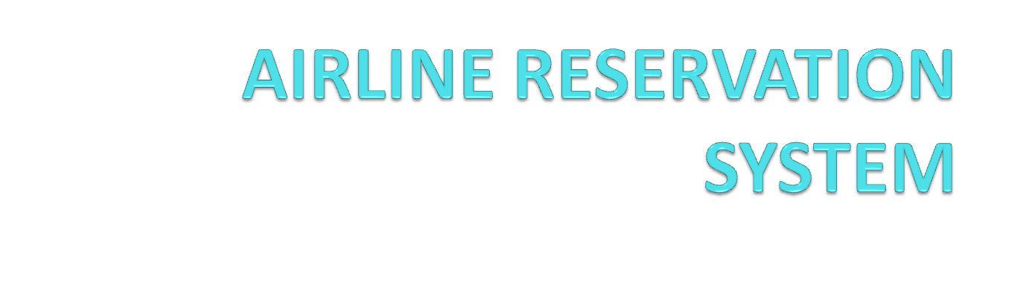

Slide 2
ABSTRACT
  OBJECTIVE:
Airline Reservation System contains the details about flight schedules and its fare tariffs, passenger reservations and ticket records. An airline’s inventory contains all flights with their available seats. The inventory of an airline service is generally divided into three category of classes (e.g. First, Business or Economy class) and each category is having seats up to 26 bookings, along with prices and booking conditions. Inventory data is imported and maintained through a Schedule Distribution System over standardized interfaces. One of the core functions of the inventory management of airline reservations is the inventory control. Inventory control steers how many seats are available for the different booking classes, by opening and closing individual booking classes for sale. In combination with the fares and booking conditions stored in the Fare Quote System the price for each sold seat is determined.

Slide 3
MODULES
Registration module
Administrative module
Passenger module

Slide 4
1. Registration module
In registration module first we ask passenger to give his details.After registering with us the passenger can logon to his/her own account and can view all flight details such as Timings, Prices,Availability of seats and can book the ticket with unique ticket id.Once Passenger registered with us can book any number of tickets.

Slide 5
2. Administrative module
Administrative module is provided for the sake of administrators to manage the site and update the content at regular intervals, The major operations included in this module are:
Create and maintain airline schedule, fare and timings of the Flight.
View the passenger list.
View the available seats in the flights.
Cancel the tickets.
Updating the flight schedule and timings and fare.

Slide 6
3. Passenger module
This module is meant for passengers, where a user logging into his/her owns account will view this panel. The major operations included in this module were
View all airline schedules, timings, fare details and seats availability.
Book for the tickets.
View and cancelling of the ticket.
Send feedback

Slide 7
3. SCOPE & PURPOSE
3.1 PURPOSE:
Airline Reservation System contains the details about flight schedules and its fare tariffs, passenger reservations and ticket records.
The inventory of an airline service is generally divided into three category of classes (e.g. First, Business or Economy class) and each category is having seats up to 26 bookings, along with prices and booking conditions.

Slide 8
  SCOPE:
Inventory control steers how many seats are available for the different booking classes, by opening and closing individual booking classes for sale. In combination with the fares and booking conditions stored in the Fare Quote System the price for each sold seat is determined.

Slide 9
EXISTING SYSTEM
In few countries if a person wants to book a flight ticket, he use to follow one of these things:
Manually goes to the Airport and book his ticket.
Downloading the ticket form as paper document, filling it manually and submitting it at Airport.
Fill the Ticket form on system and get the print out as paper documents to submit it at Airport.
Booking the Ticket at some particular registered ticket counters in online.
Even above approaches make a ticket booking online, it was not completely done on online. Passenger may not have much freedom over this approach.
Hence the Passenger may or may not be satisfied with this approach as it includes manual intervention like travelling to Airport for booking his ticket.

Slide 10
PROPOSED SYSTEM:
The Proposed system ensures the complete freedom for users, where user at his own system can logon to this website and can book his ticket. Our proposed system allows only registered users to book the tickets, view timings and cancel their tickets.
In this Proposal the entire work is done on online and ticket with id is also provided for passengers as a print document. Here passengers can send their queries and suggestions through a feedback form.

Slide 11
SYSTEM ARCHITECTURE
The application will follow three-tier architecture. In three-tier architecture application will run the traditional client/server model but from the web server. The client only displays the GUI and data but has no part in producing results.

Slide 12
Three-tier architecture will contain the following tiers
Client/Presentation Tier:
This tier includes all the HTML content or forms to be displayed on the client browser. It is the form which provides the user interface to end user. Programmer uses this tier to get or set the data back and forth.
Business Logic Layer
In the Business logic tier, the actual processing of the data and the logic behind the implementation of the application will be present. This tier can contain a class, which can be used to write the functions, and also works as a mediator between the presentation tier and data tiers.

Slide 13
Data Tier:
Data Tier contains methods and classes that deal with passing and storing data to the data Storage Layer. Queries or stored procedures are used to access the data from the database or to perform any operation to the database. It stores the data passed by the presentation tier.

Slide 14
SYSTEM DESIGN
Unified Modeling Language:
UML stands for Unified Modeling Language. It is a third generation method for specifying, visualizing and documenting the artifacts of an object oriented system under development. Object modeling is the process by which the logical objects in the real world (problem space) are represented (mapped) by the actual objects in the program (logical or a mini world). This visual representation of the objects, their relationships and their structures is for the ease of understanding. This is a step while developing any product after analysis.

Slide 15
The Unified Modeling Language encompasses a number of models.
Use case diagrams
Class diagrams
Sequence diagrams

Slide 16
Use Case Diagram:
Use case diagram consists of use cases and actors and shows the interaction between them. The key points are:
The main purpose is to show the interaction between the use cases and the actor.
To represent the system requirement from user’s perspective.
The use cases are the functions that are to be performed in the module.
An actor could be the end-user of the system or an external system.

Slide 17
Login
Scheduling flights
View passenger list
ADMIN
Cancel the ticket
view feedback
Log out

Slide 18
Register
Login
View flight timings
and availability
Book the ticket
Send cancel request
USER
Send feedback
Log out

Slide 19
Sequence Diagram:
The purpose of sequence diagram is to show the flow of functionality through a use case. In other words, we call it a mapping process in terms of data transfers from the actor through the corresponding objects.

Slide 20


Slide 21
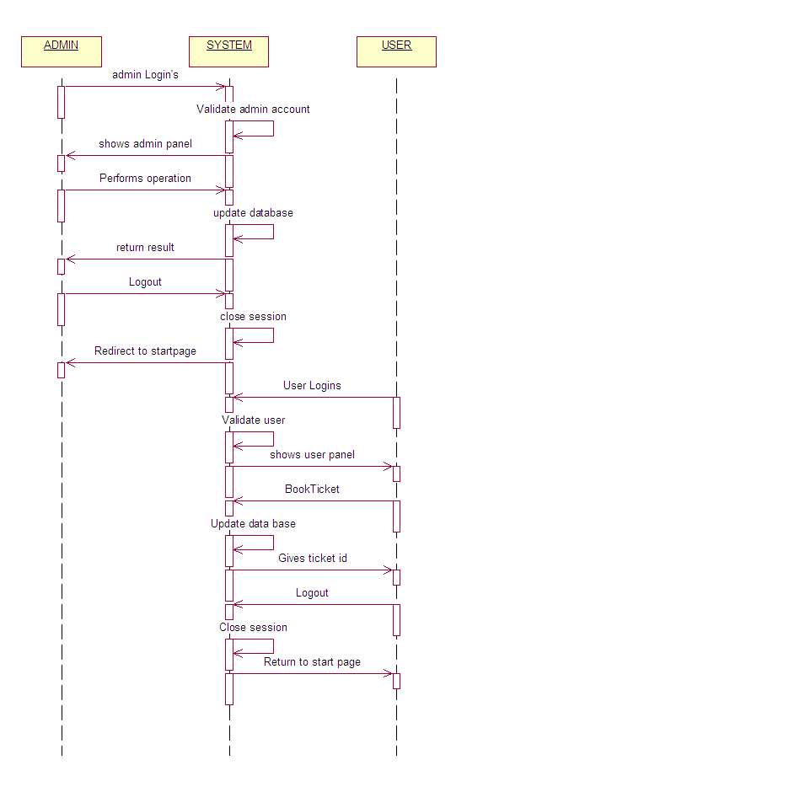

Slide 22


Slide 23
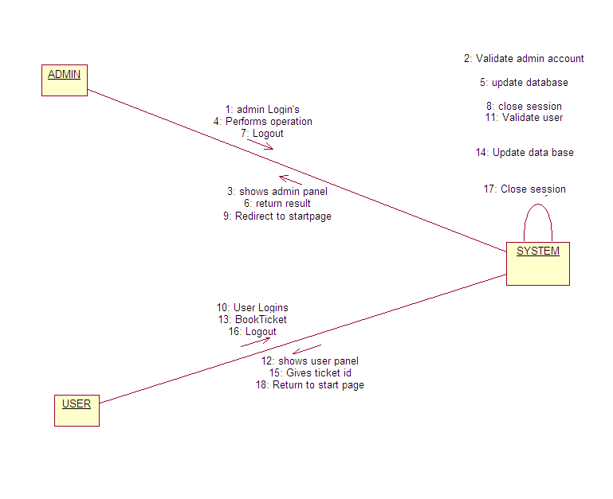

Slide 24


Slide 25
TICKET BOOKING
Books
LOGIN
Ticket id no
Loginnamee
Type
No.passengers
Passengername
Password
Mobile
DestinationStationon
Name
Gender
FligthName
SourceStation
Depends
Location
Gives
Destination Station
SCHEDULING
ID
FEEDBACK
Time
Seats
Name
Subject
Flightname
Sourcestation
Email

Slide 26
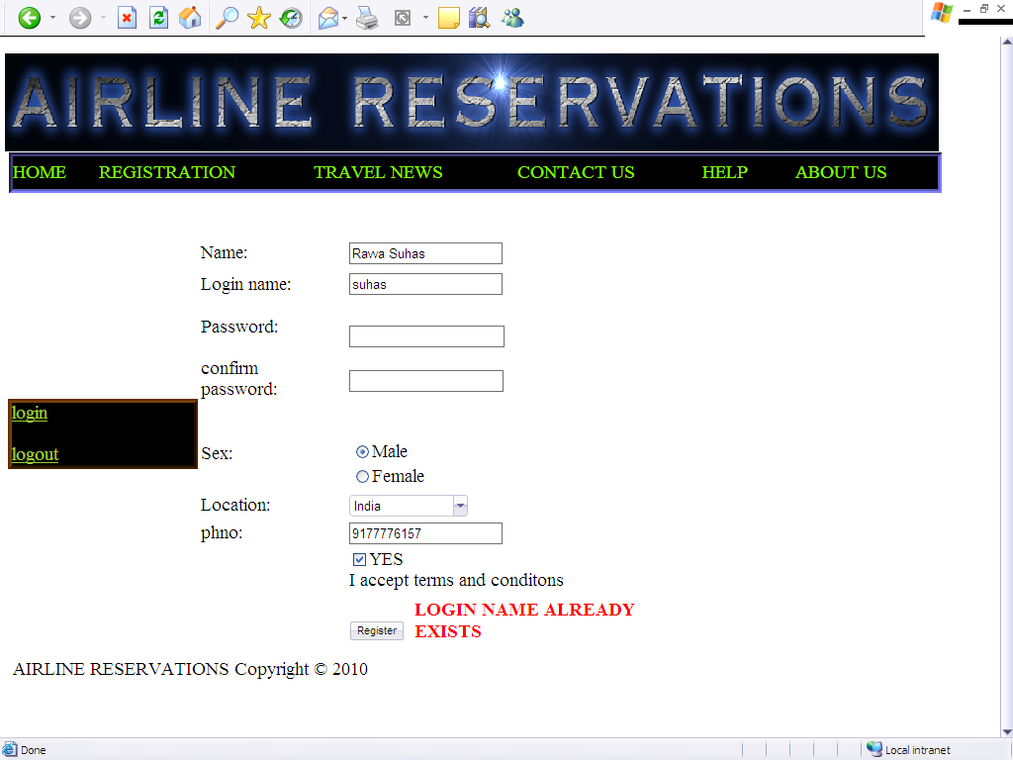
TEST CASES SCREENS

Slide 27
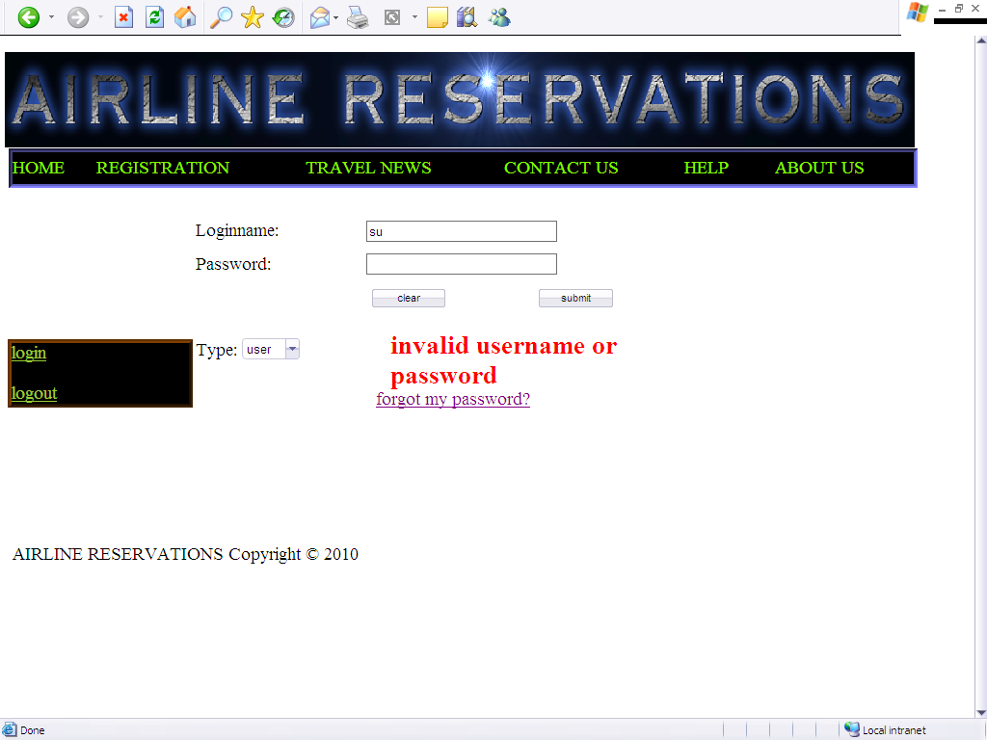

Slide 28
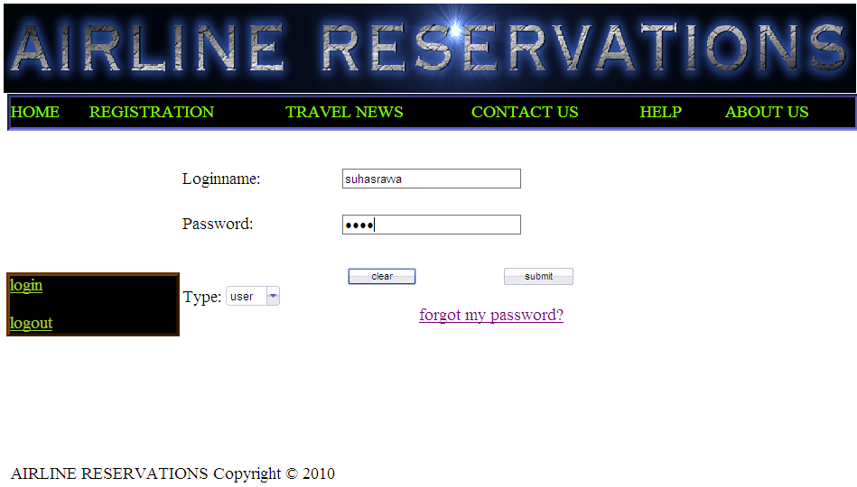
LOGIN FORM

Slide 29
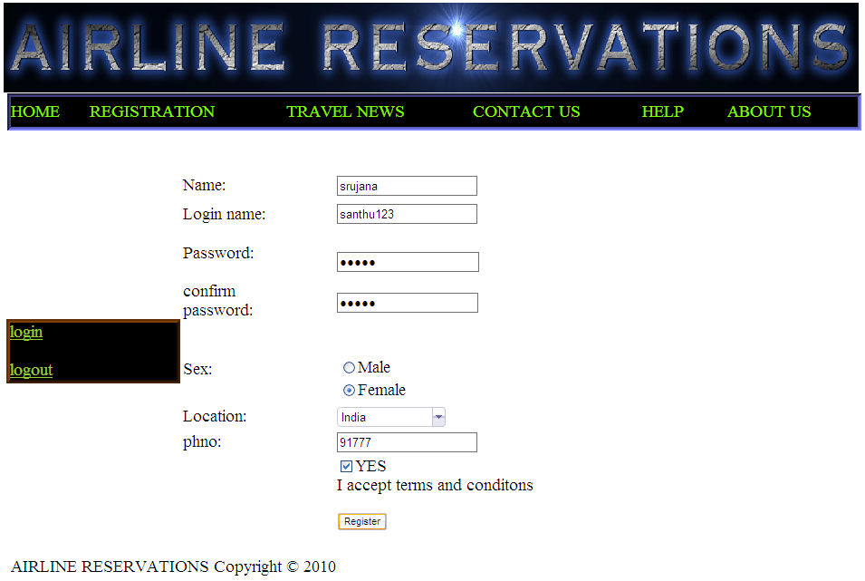
REGISTRATION FORM

Slide 30
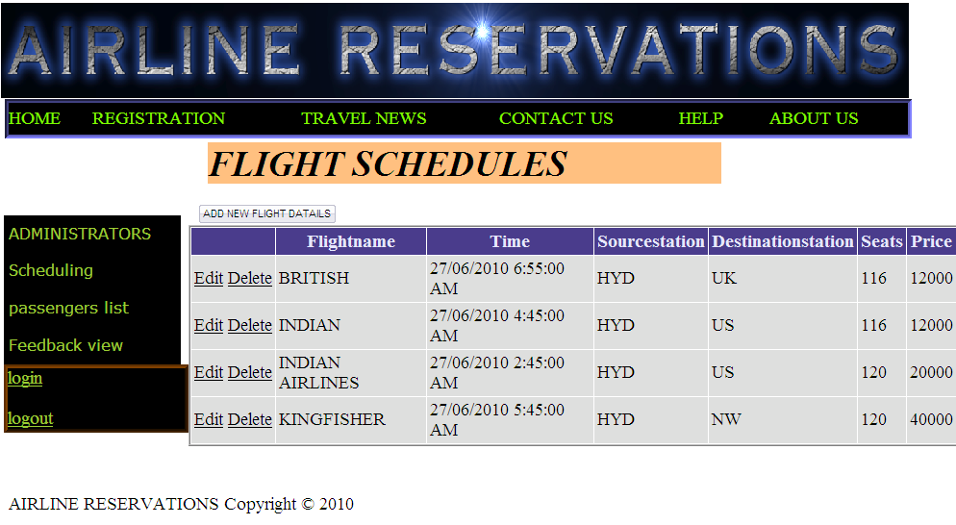
FLIGHT SCHEDULES

Slide 31
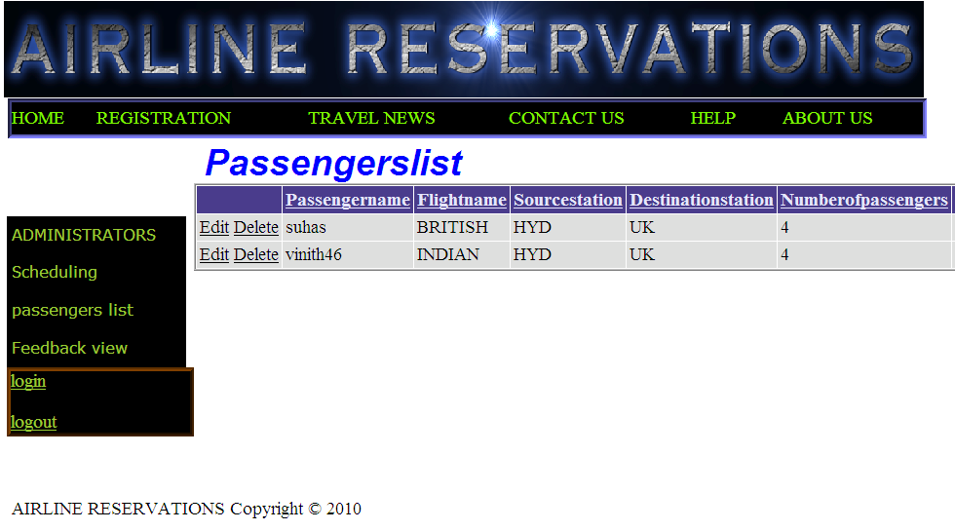
PASSENGERS LIST

Slide 32
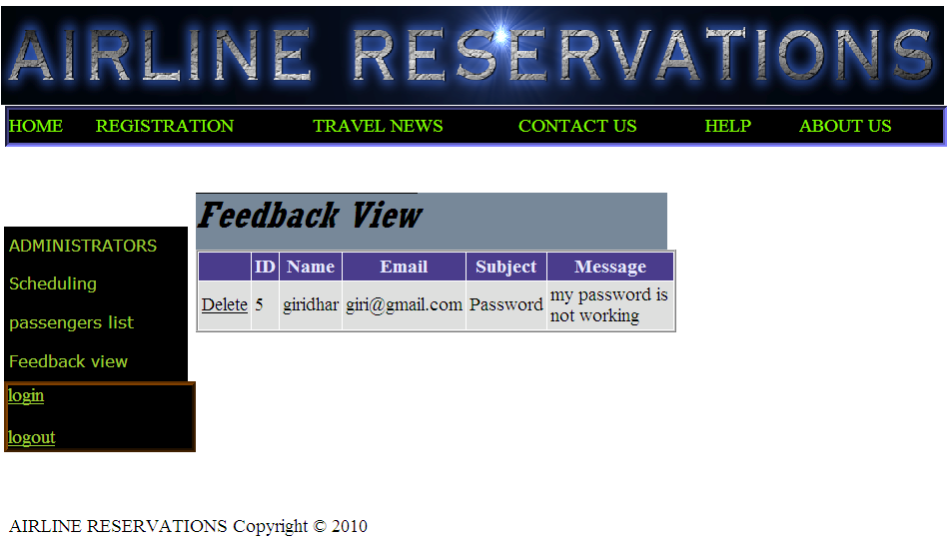
FEEDBACK VIEW

Slide 33
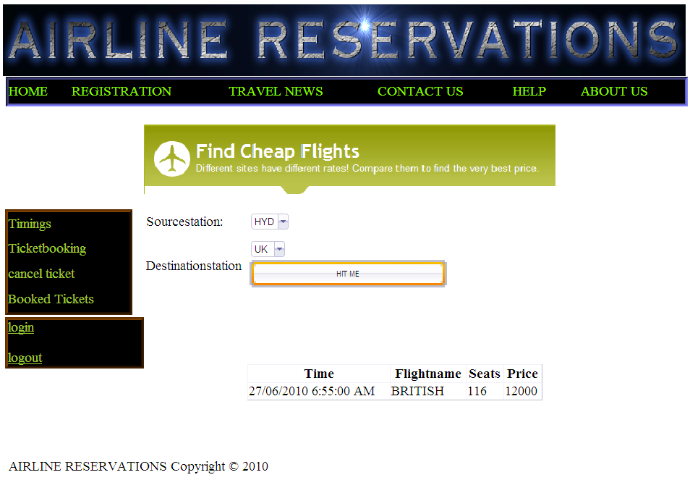
TIMINGS OF FLIGHTS

Slide 34
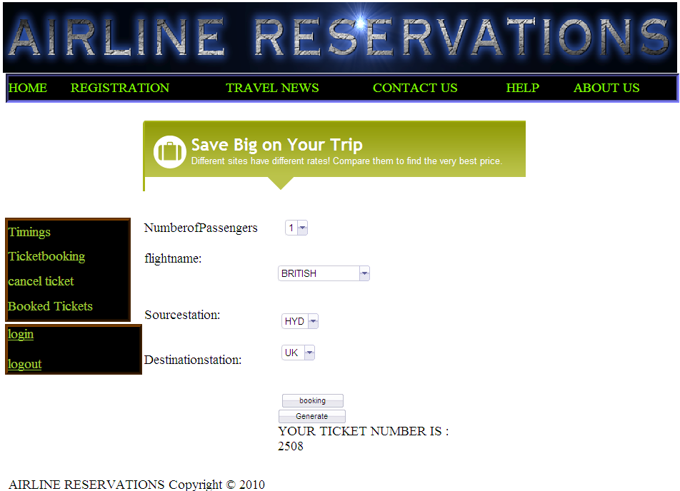
TICKET BOOKING

Slide 35
CONCLUSION & FUTURE SCOPE
Getting accurate information about what visas or permits you need is an important part of preparing for a trip or stay abroad. To help you with this task we have provided information about embassies and consulates abroad, and we have also included companies that provide visa and passport services.
We offer documentation processing, application & filing services for those interested in applying for a visa.A strong research team ensures that cases are evaluated and processed as per the latest updated rules and regulations.

Slide 36
BIBLIOGRAPHY
FOR .NET INSTALLATION
www.support.mircosoft.com
FOR DEPLOYMENT AND PACKING ON SERVER
www.developer.com
www.15seconds.com
FOR SQL
www.msdn.microsoft.com
FOR ASP.NET
www.asp.net
www.asptoday.com
www.aspfree.com

